Slide 1




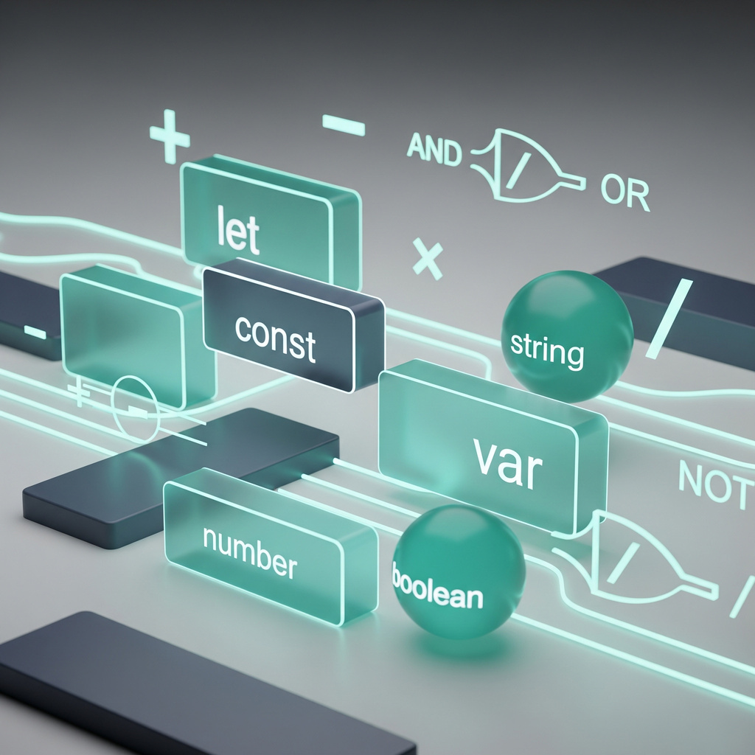





DATA ANALYSIS
JAVASCRIPT FUNDAMENTALS
Module 3: SQL and Databases
Module 3: SQL & Databases
AI-Augmented SQL
Primitive
Data Types
Topic 5 of 6
Topic 6 of 6

Slide 2


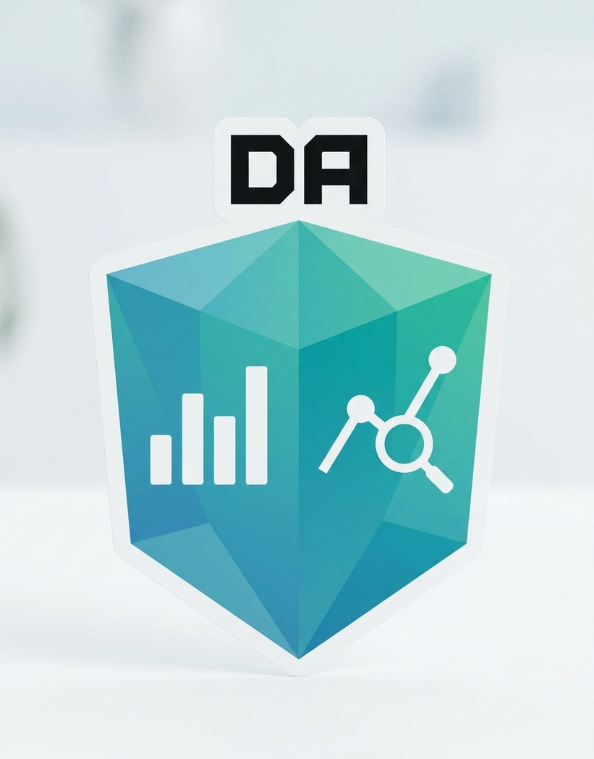


Learning outcome
By the end of this topic, the trainee can…
1-
2-
3-
By the end of this topic, the trainee can…
1- Turn a business question into a natural-language prompt precise enough to produce a correct SQL query.
2- Spot the errors AI commonly makes — wrong join type, wrong COUNT, misplaced clauses — before running anything.
3- Use prediction and known references — the same habits from 3.3 and 3.4 — to confirm AI's answer is actually right.

Slide 3
Why this matters
Damilola's first AI-assisted report
Damilola, new on the analytics team, asks an AI assistant to write a query counting customers who ordered in Q1 2026.
The AI replies instantly with a clean, confident-looking query. It runs without error and returns a number.
Damilola pastes the number straight into the board deck. It's wrong — quietly, not loudly. No error, no crash, just the wrong answer, presented with total confidence.
Nobody catches it until finance's own count doesn't match, three days later.
A query that runs is not
the same as correct
AI is fluent, not accountable. Every habit this module built — predicting, verifying, reading a schema — exists for exactly this moment.

Slide 4
CONCEPT 1 OF 7
How far the ladder has come
Trainee prompting skill was never meant to stay at Week 1 level — it climbed a rung with every topic.
Trainee's job
Topic
AI's role
Understand it
3.1
Explain a concept or term
Write the query by hand
3.2
Explain an error message
Write, predict, verify every query
3.3–3.5
Explain errors; never write queries
Judge, audit and verify AI's query before trusting it
3.6 (today)
Write the full query from a prompt
The jump: AI finally gets to write the SQL. That's only safe because every topic before this one was building your ability to judge whether it's right.

Slide 5
CONCEPT 2 OF 7
A good prompt names the business logic, not just the tables
✗ Vague
✓ Precise
“Write a query to count customers who ordered in Q1 2026.”
“Using our customers and orders tables, count the DISTINCT customers who placed at least one order between 2026-01-01 and 2026-03-31 inclusive. Return a single number.”
Doesn't say unique customers — AI may count orders instead.
Doesn't say what “Q1 2026” means as exact dates.
Doesn't say what shape the answer should take.
Names the tables and the exact business logic: distinct customers.
Spells out the date range as exact, inclusive bounds.
States the expected output shape.

Slide 6
CONCEPT 3 OF 7
Mistakes AI makes with quiet confidence
Mistake
Why it's dangerous
Where you learned to catch it
COUNT(*) instead of COUNT(DISTINCT col)
Inflates counts across a one-to-many join
3.3 — COUNT(*) vs. COUNT(column)
INNER JOIN instead of LEFT JOIN
Silently drops rows with no match
3.4 — choosing the right join
WHERE where HAVING belongs
Filters at the wrong stage, or errors outright
3.3 — WHERE vs. HAVING
Exclusive date bound (< instead of <=)
Quietly misses the last day of a range
3.2 — comparison operators
None of these are new: every mistake in this list is a concept you've already learned to reason about — you're just aiming that reasoning at someone else's query now.

Slide 7
CONCEPT 4 OF 7
Five checks, before you run anything
1
2
3
4
5
Schema check
Clause check
Join check
Predict
Verify
Do the tables and columns actually exist, and mean what AI assumed?
Right order? WHERE vs HAVING used correctly?
Right join type — does this question need unmatched rows kept?
What row count or value do you expect, and why, before running it?
Run it. Compare to your prediction and any known reference.
Same five checks for every AI-written query, every time — not just when something looks suspicious.

Slide 8
CONCEPT 5 OF 7
Verifying AI's answer is the same habit, aimed differently
3.3 taught you to check a total against a known reference figure before trusting it.
3.4 taught you to predict a join's row count before running it.
Today, both habits point at AI's output instead of your own — the discipline doesn't change, only whose query you're checking.
From 3.3
From 3.4
Reference check
Row-count prediction
Does AI's number agree with something already trusted — a report, a dashboard, a hand count?
Does the number of rows AI's query returns match what the schema and the question say it should?

Slide 9
CONCEPT 6 OF 7
Ship it, fix it, or ask again?
Situation
What to do
Result matches your prediction and any known reference
Ship it — you've verified it, not just run it
Result is close, but off in a way you can explain
Fix the specific clause yourself — you know exactly what's wrong
Result is wrong and you don't see why
Ask AI to explain its query line by line — don't just ask it to “try again”
Still wrong after an explanation
Write it yourself from the schema — you have every skill from 3.1–3.5 to do it
Never acceptable: regenerating the same prompt repeatedly and hoping a different answer happens to look right.

Slide 10
CONCEPT 7 OF 7
Everything converges on the same query shape
Whether you write it or AI does, every query — OLTP or warehouse — still follows the one skeleton from the whole module.
SELECT
→
FROM
→
JOIN…ON
→
WHERE
→
GROUP BY
→
HAVING
→
ORDER BY
3.2
3.2
3.4
3.2
3.3
3.3
3.2
What's actually new today
Not a clause. Not a function. Not a join type.
The new skill is deciding whether someone else's query — AI's — uses this skeleton correctly, before you trust its answer.

Slide 11
WORKED EXAMPLE · PART 1 OF 2
Auditing Damilola's query
Business question: “How many unique customers ordered something in Q1 2026?”
The prompt Damilola actually used
“Write a SQL query to count how many customers ordered something in the first quarter of 2026, using our customers and orders tables.”
What the AI wrote back
SELECT COUNT(*) AS customer_count
FROM customers c
JOIN orders o ON c.customer_id = o.customer_id
WHERE o.order_date >= '2026-01-01' AND o.order_date <= '2026-03-31';

Slide 12
WORKED EXAMPLE · PART 2 OF 2
Predicting, catching the bug, and fixing it
Step 1 — predict first
Step 3 — find it: COUNT(*), not DISTINCT
From the 3.4 dataset: Chidinma (2 orders, Jan+Feb) and Aisha (1 order, March) ordered in Q1. That's 2 unique customers — the expected answer.
The JOIN produces one row per order, not per customer. Chidinma's 2 orders each add 1 to COUNT(*) — she's counted twice. The prompt never said “unique.”
Step 2 — run it. Mismatch.
customer_count
SELECT COUNT(DISTINCT c.customer_id) AS customer_count
FROM customers c
JOIN orders o ON c.customer_id = o.customer_id
WHERE o.order_date BETWEEN '2026-01-01' AND '2026-03-31';
3
AI's query returns 3, not 2. Something's wrong — time to find it, not to shrug and paste it in.
Fixed: COUNT(DISTINCT c.customer_id) now returns 2, matching the prediction.

Slide 13
GUIDED PRACTICE · YOUR TURN
Audit a second AI-written query
Business question: “List every customer's name with their total number of orders — including customers who haven't ordered yet, shown as 0.”
SELECT c.full_name, COUNT(o.order_id) AS order_count
FROM customers c
INNER JOIN orders o ON c.customer_id = o.customer_id
GROUP BY c.full_name;
Your task
Hint, if stuck
Predict how many rows the correct answer should have.
Run the checklist from concept 4 on this query.
Find the bug, fix it, and re-verify.
The dataset from 3.4 had 5 customers, 2 of whom (Tunde, Ngozi) had never ordered. What should the row count be — and does this query's join type deliver that?

Slide 14
GUIDED PRACTICE · SOLUTION
INNER JOIN was silently dropping customers
✗ AI's version
✓ Fixed
INNER JOIN orders o
ON c.customer_id = o.customer_id
LEFT JOIN orders o
ON c.customer_id = o.customer_id
Predicted 5 rows (one per customer). Got 3 — Tunde and Ngozi vanished because INNER JOIN drops customers with no matching order.
LEFT JOIN keeps every customer. Tunde and Ngozi now appear with order_count = 0, exactly as the business question asked.
Why COUNT(o.order_id), not COUNT(*): with LEFT JOIN, unmatched customers get a NULL order_id — COUNT(o.order_id) correctly skips it and reports 0, while COUNT(*) would wrongly report 1.

Slide 15
Key takeaways
✓
You can now translate a question into a good prompt
Module 3
Complete
✓
3.1 Schema & keys
3.2 SELECT / WHERE / ORDER BY
3.3 GROUP BY / HAVING
3.4 Joins & subqueries
3.5 Warehousing
3.6 AI-augmented SQL
✓
Topic 6 of 6
Notes:
Read each 'you can now' aloud with a thumbs-up/down check, then let the Module 3 checklist land as a real moment — six topics, each building on the last. Next up is the graded query set, covered on the following slide. Timing: 3 minutes.

Slide 16
Key Takeaways
You can now translate a question into a good prompt: Name the tables, the exact business logic, and the expected output — don't leave AI to guess.
You can now critically read AI-written SQL: Run the five-check list — schema, clauses, join type, predict, verify — on every query AI hands you.
You can now verify results against expected outputs: Row-count prediction and reference checks work exactly the same whether you or AI wrote the query.

Slide 17
WHAT'S NEXT
The Module 3 graded query set
1
2
3
What it covers
What's graded
How to prepare
Business questions spanning every topic — schema reading, filtering, aggregation, joins, and at least one AI-assisted query you must audit.
Not just a correct final answer — your written prediction and verification step for each query matter as much as the SQL itself.
Revisit each topic's recap slide. For every practice query, ask: did I predict first? Did I verify against something known?
Facilitator note: the graded query set's rubric and sample questions are attached on the LMS. Confirm every trainee can articulate the five-check checklist from concept 4 before the session ends.

